Slide 1
COMPUTER VISION
Sentiment Analysis of Faces using Facial Landmarks

Slide 2
Introduction
With about 1 billion hours of videos uploaded on Youtube daily, 95 million photos and videos on Instagram every day and CISCO’s projection that 82% of the global internet traffic will come from videos by 2021, it becomes so important that the computer learns how to understand these contents.

Slide 3

Type to enter a caption.

Slide 4
5. Methodology and Intuition
The intuition behind our approach is that the human expression for instance happiness and sadness are contained in the face, the more features the machine can associate to any of these targets, the more accurate the computer will be at classifying the human sentiment.

Slide 5
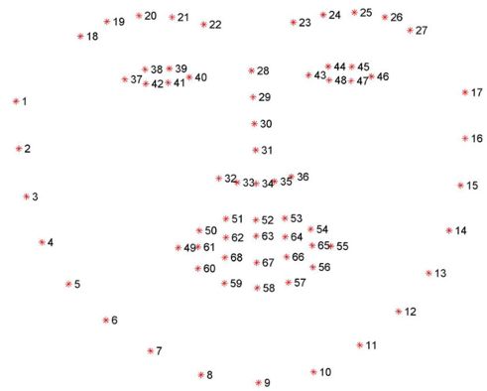
Type to enter a caption.

Slide 6
Data Collection
The model was trained using 988 images from Flickr, Pinterest and Google image search results and we ended up with about 804 happy human faces and 508 sad human faces.
Sample edge of a dog

Slide 7
The regression tree method implemented in dlib (David King) which uses an Histogram of Oriented Gradient for detecting the faces with a linear classifier and image pyramid in a sliding window detection was used for detecting human faces and extracting the 68 facial landmark features on these faces. The extracted features are then used to train a machine learning model with a voting ensemble of Support Vector Machine, Decision Tree Classifier, K Neighbors Classifier and an Xgboost.
Machine learning techniques that combines several base models in order to produce one optimal predictive model, hence this single model gives a better predictive outcome

Slide 8
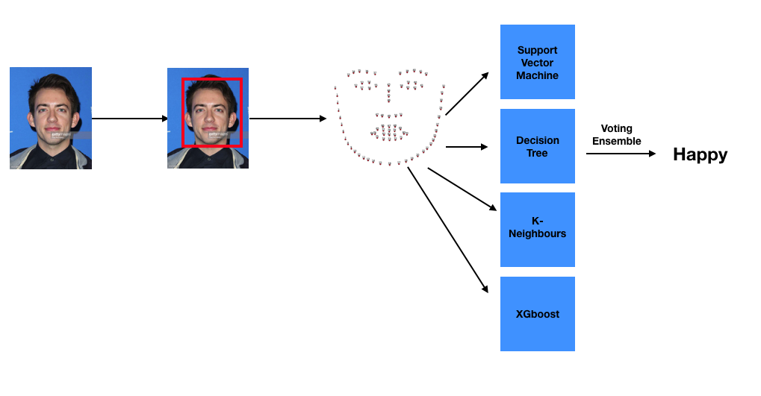
Model Architecture

Slide 9
Relevant links
https://www.slideshare.net/adewole63/optimization-of-facial-landmark-for-sentiment-analysis-on-images-with-human-faces
https://github.com/Free-tek/Sentiment_Analysis_For_Human_Face

